Slide 1
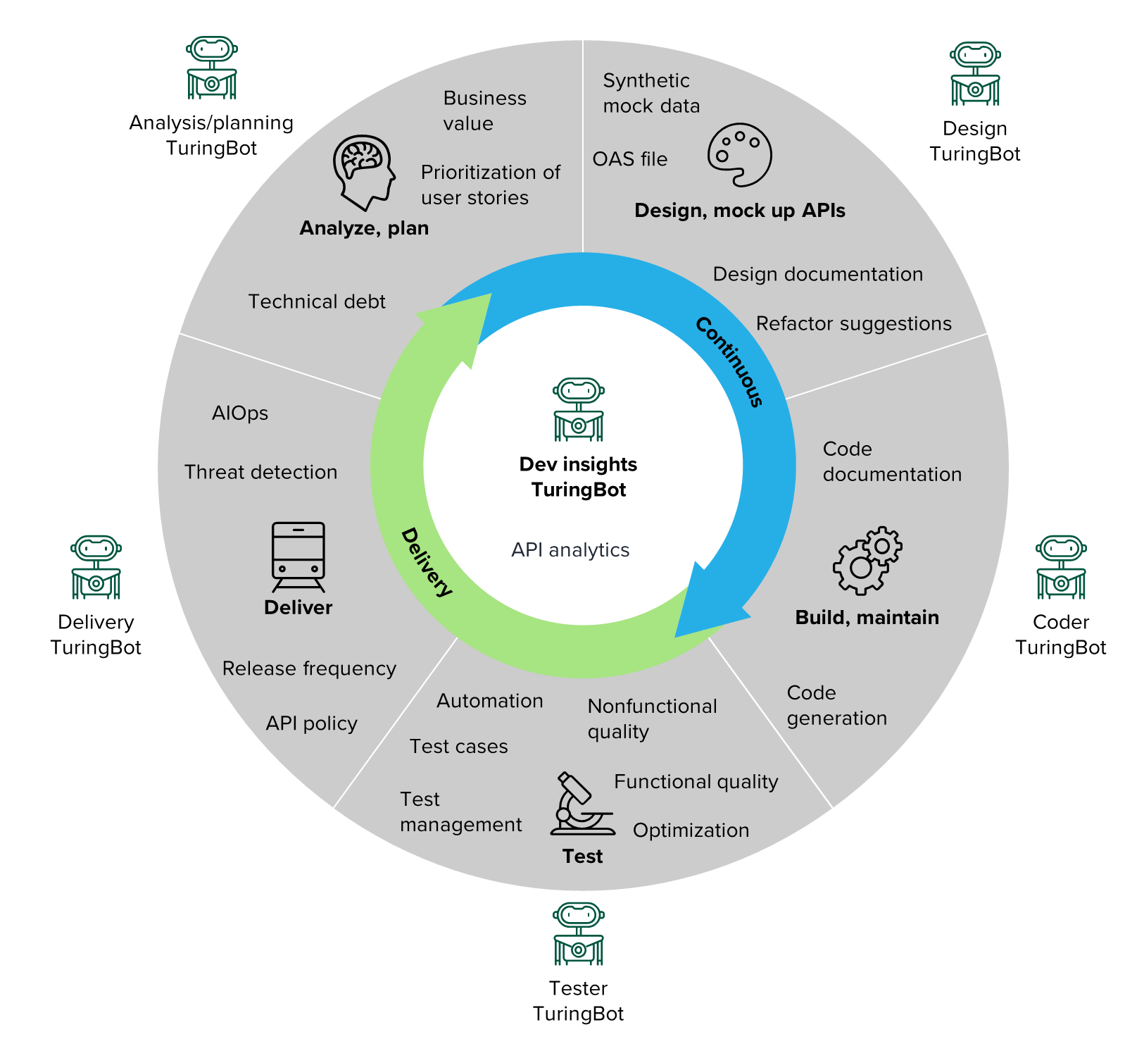
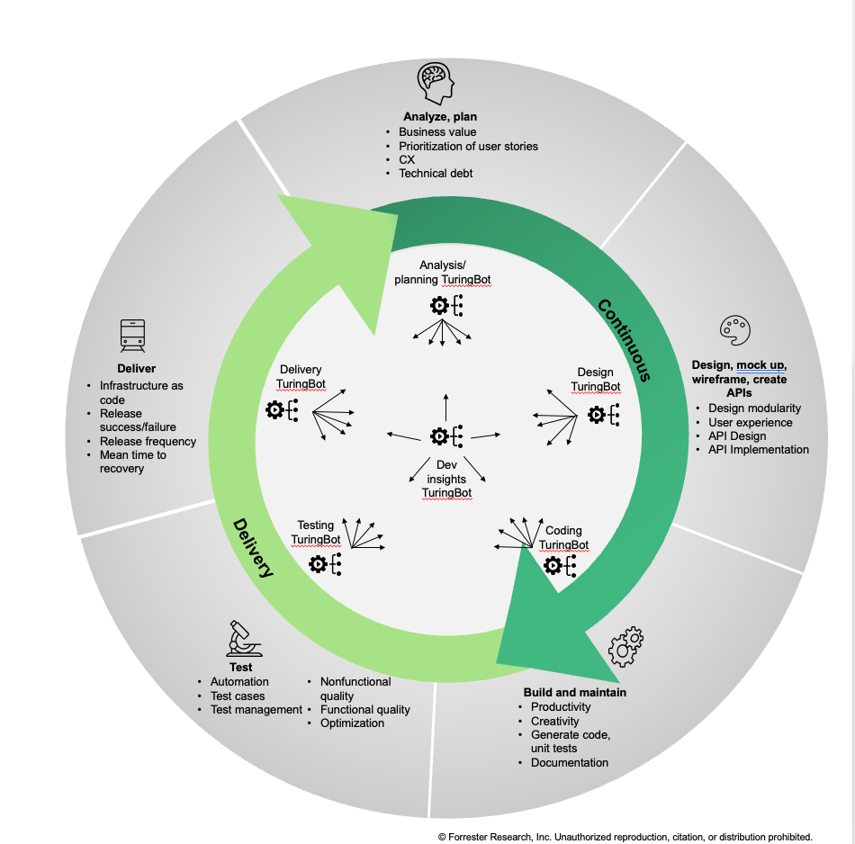
From TuringBots to Agentic Software Development
Analyze, plan
Business value
Prioritization of user stories
CX
Technical debt
Deliver
Infrastructure as code
Release success/failure
Release frequency
Mean time
to recovery
Design
Agentic Software Development
Design modularity
User experience
Mockup, wireframe, create APIs
Test
Automation
Test cases
Test management
Nonfunctional quality
Functional quality
Optimization
Build, maintain
Productivity
Creativity
Generation of code, unit tests
Documentation
2023-2024
2025
2026 +

